Slide 1

Game Blackjack
Presented by Hai Do
Class: C0322H1

Slide 2
OUT LINE
Game Blackjack explanation
Project segments
What do I gain?
What are the difficulties?
What need to improve?
How do I overcome it?
Conclusion

Slide 3
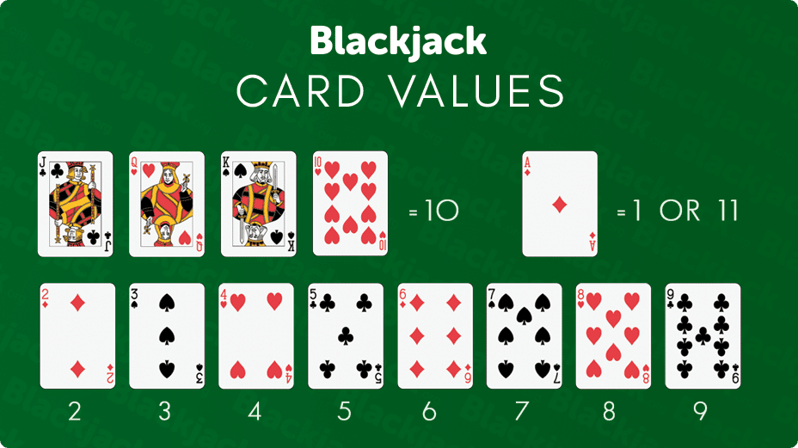
Game Blackjack explanation
Chia mỗi người 2 lá bài, người chơi được tùy chọn bốc thêm bài hoặc dừng. Nhà cái sẽ bốc bài sau cùng
Nếu người chơi quá 21 điểm thì thua luôn, không cần quan tâm đến số điểm của nhà cái
Xì dách: người chơi có 1 lá Ace và thêm một trong các lá 10, J, Q, K. x2 betting

Slide 4
PROJECT SEGMENTS
Planning & Analyzing project
Debugging & improvement
Implement plant,
Code accordingly

Slide 5
OBJECT ANALYZING
Card-Deck
CardsDeck ShuffleDeck GetRandomCard
Display card
Player
Get card Show Card
Dealer
Name Score live Status Flag Ace Flag Picture Coins
Value Suit Score
52 cards
Flag Ace Flag Picture
Card
Get Card Show Card

Slide 6
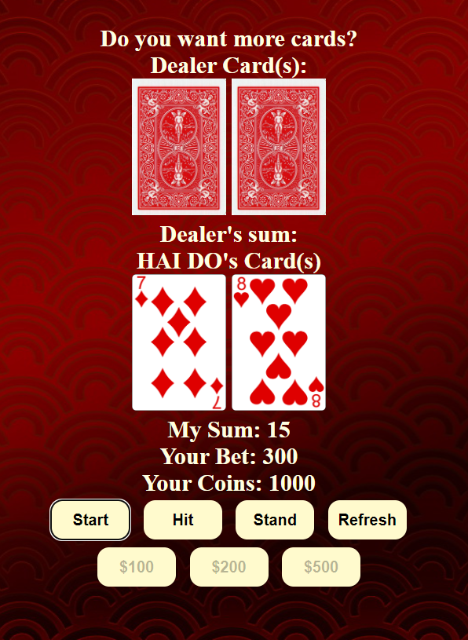
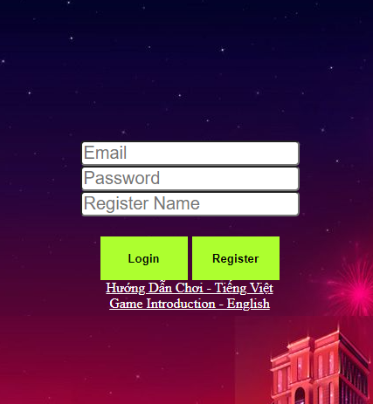
GAME DESIGN

Slide 7

WHAT DO I GAIN THROUGH CASE STUDY
Great practice OOP approach
Exercise all the lesson that have learned in Module 1
Customizing module 1 knowledge for the case study.

Slide 8

What are the difficulties?
Planning is not as close to the project being
Limited knowledge in CSS => poor interface, terrible animation, and game effect.
Clean code problem => possible bugs, and hard to update code.

Slide 9
How do I overcome it?
Put more effort to game analyzing.
Seeking professor opinion on planning statement
Improving CSS and front-end skills

Slide 10
What would I do, If I have to run the project again? Or the similar project?

Slide 11
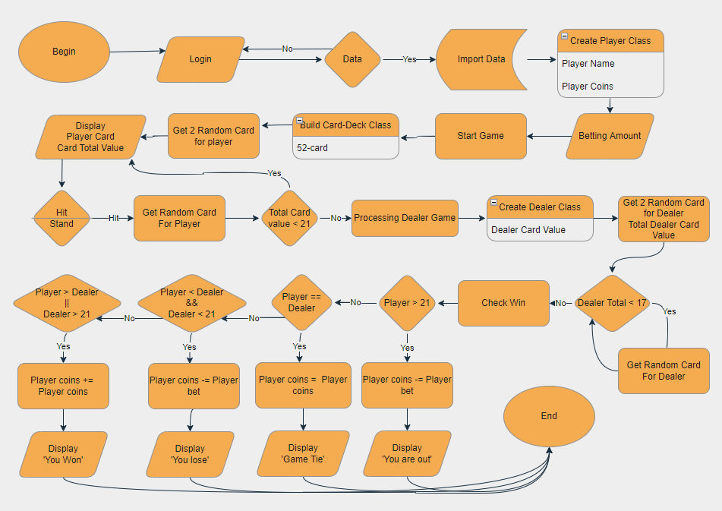

Slide 12
Thank you for listening

Slide 13
Any question?

